Slide 1
SEED Presentation
Group 6 Wild swans

Slide 2
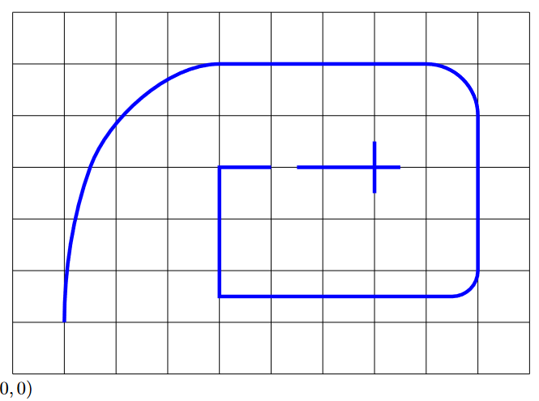

Introduction
Design a line following robot
Notes:
Warehouse robots need to be able to follow appropriate paths in order to navigate around their workspace. We will design and build a robot that can follow a path defined by 1" wide blue painter’s tape. The robot must be able to keep its rotational center within 1 foot of the tape at all times. The path to be followed will be approximately as given by the image on the slide. The robot’s success will be determined by how far it is able to make it down the path, and the speed at which it travels. Note that there is a break in the tape at (5,4). The robot will have to successfully pass over this break. The robot should stop when it reaches the crossed tape at (7,4)

Slide 3
solution concept
Robot with two front wheels run on Arduino
Raspberry Pi with computer vision to detect line
Communication between Arduino and Raspberry Pi

Slide 4
Sim and Control

Slide 5
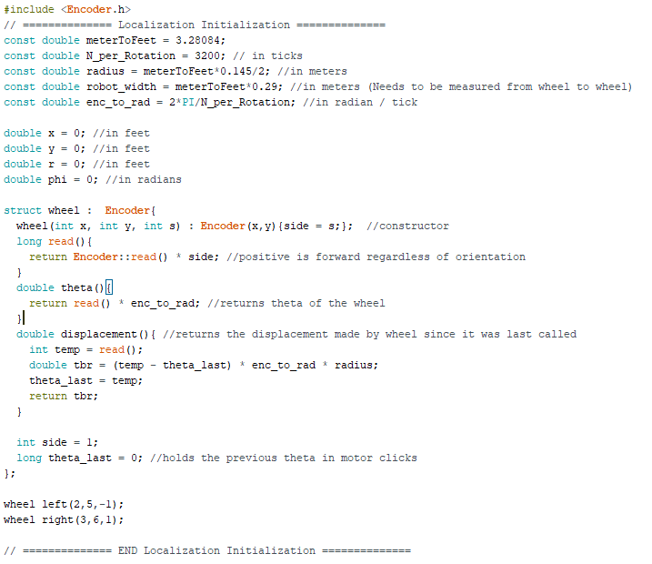
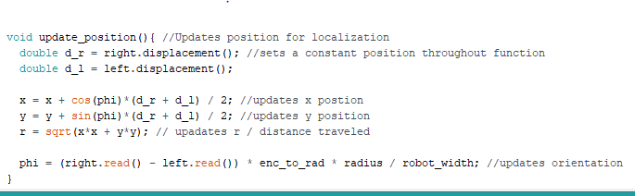
localization
Encoder.h
Useful constants
Wheel Setup
Encoder Interpretation
Position
X, Y, Phi, R
Notes:
We use the Encoder.h library to count the number of ticks made by the encoders in the motors/wheels.
The variables listed are needed or useful for determining the position. (meterToFeet converts a meter measurement to feet. Since we had better precision using metric on the meter stick we measured in metric. Radius and robot_width are needed to determine how much the bot has actually moved and turned. Enc_to_rad can be used to convert encoder readings into a radian value. Then position variables are initialized to 0.
A Wheel structure was made in order to keep code organized. It inherits the properties of an encoder class and adds some functionality to it: orientation interpretation (left side vs right), and variable storage for position interpretation. Two wheel objects are initialized to keep track of the wheels on the robot
Our position updates every iteration of void loop(). It takes the displacement made by the left and right wheels since it was last checked and uses these to calculate x and y. x and y are then used to calculate the total displacement made on the robots journey.
The phi is determined based on the wheel readings instead of updating. This is because the orientation can be determined solely off of how much each wheel has moved since the program began and leaves less room for any rounding error from update to update.

Slide 6
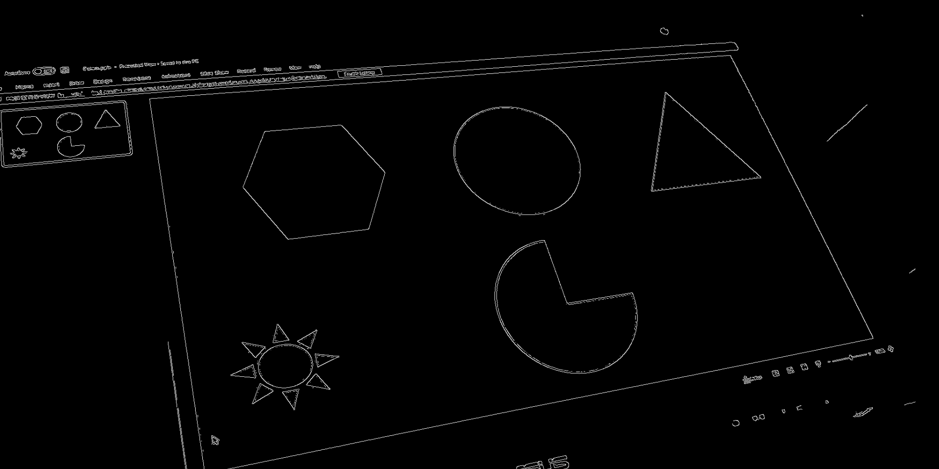
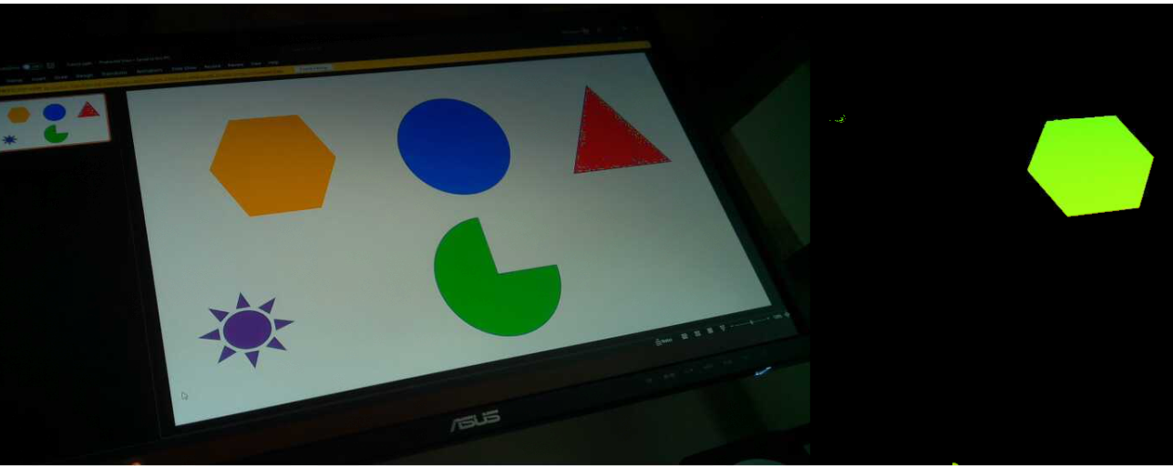
Computer vision
OpenCV
Distortion Correction
Color filtering
Noise Reduction
Contour Selection
Angle detection
Notes:
To make the robot able to interact with the world and get real time feedback we use OpenCV to implement our computer vision. The first step is to start recording video. As the video is recorded each frame has a distortion calibration matrix run on it to remove any fish eye effects the camera might have. After that, a specific color is filtered out of the image (the blue for the tape that is to be followed) and then noise reduction is done. From there the remaining contours of the image are found. The largest contour is assumed to be the tape that needs to be followed and so the angle of that largest contour away from the center of the screen is found to tell the robot what direction to turn and by how much.

Slide 7

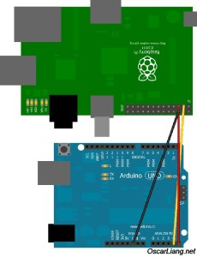
System integration
Sending data from Raspberry Pi to Arduino
I2C communication
Sending position or error of angles
LCD to display data such as position or angles

